Slide 1
NUMBERS
3
1
5
2
4
Números
6
7
8
9
10

Slide 2
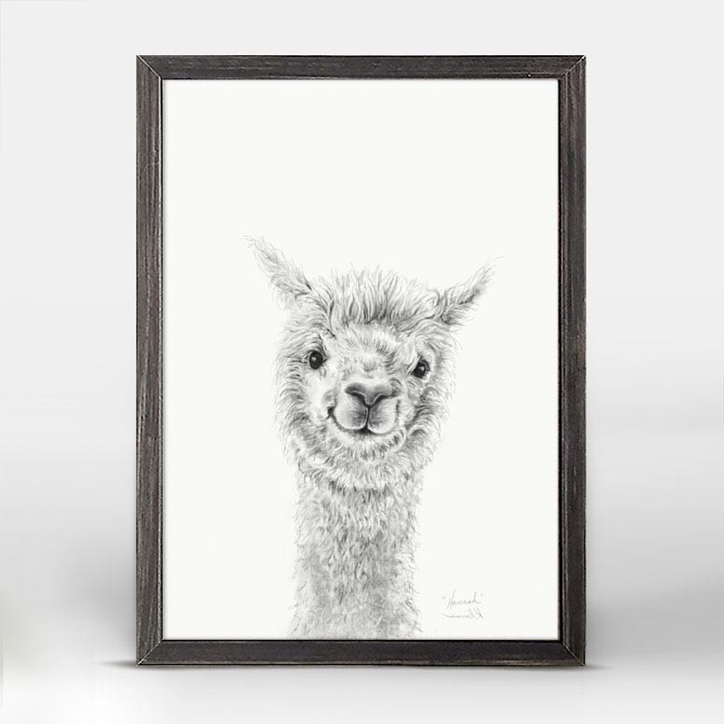
uno
1

Slide 3
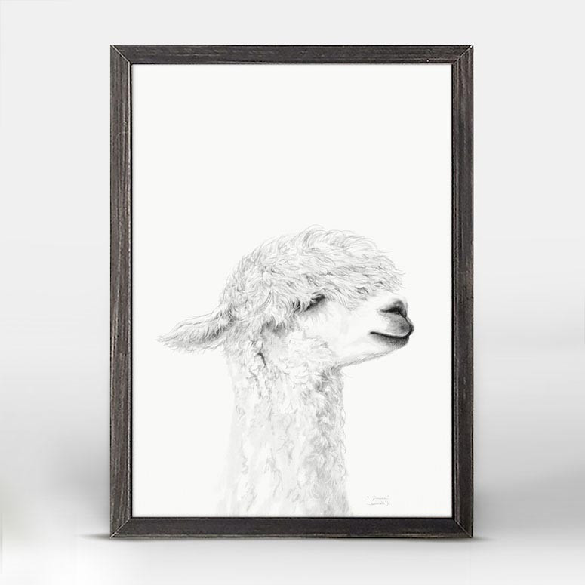
DOS
2

Slide 4
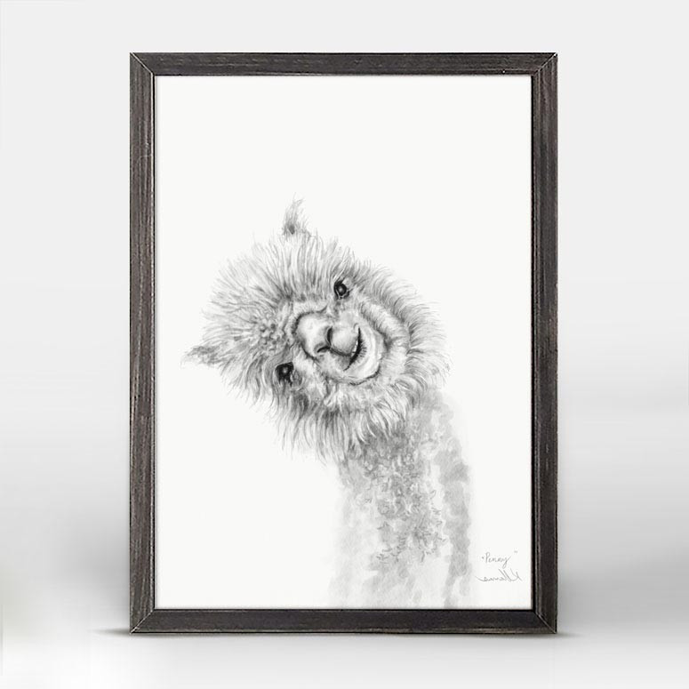
TRES
3

Slide 5
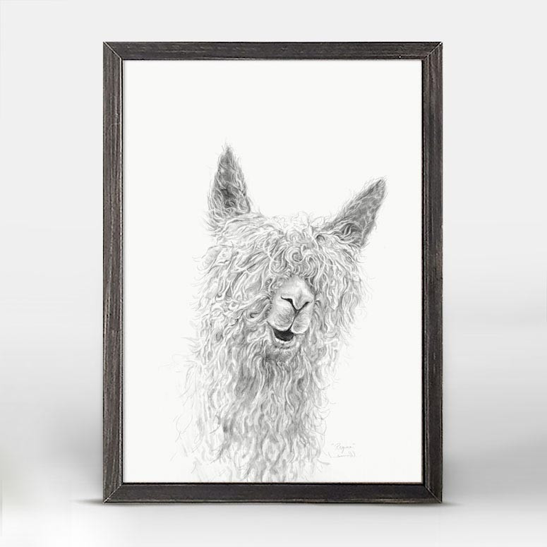
CUATRO
4

Slide 6
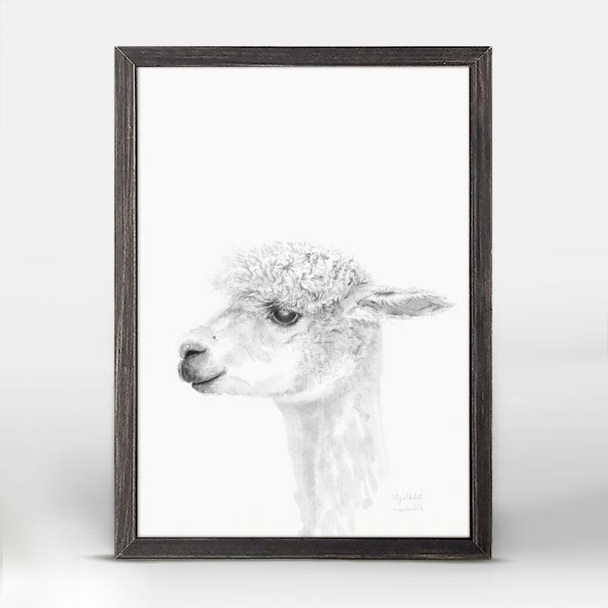
CINCO
5

Slide 7
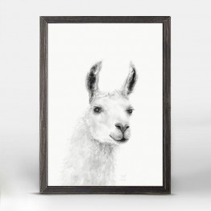
seis
6

Slide 8
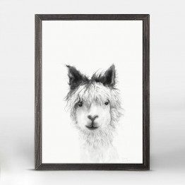
SIETE
7

Slide 9
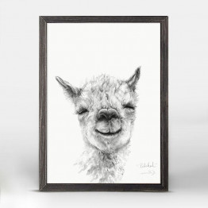
OCHO
8

Slide 10
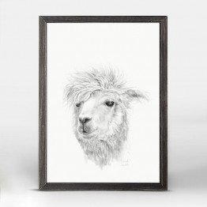
nueve
9

Slide 11
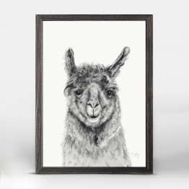
DIEZ
10

Slide 12
uno
1
6
SEIS
2
7
DOS
SIETE
3
8
TRES
OCHO
4
9
CUATRO
NUEVE
5
10
CINCO
DIEZ

Slide 13
NUMBERS
3
1
5
2
4
Números
6
7
8
9
10

Slide 14
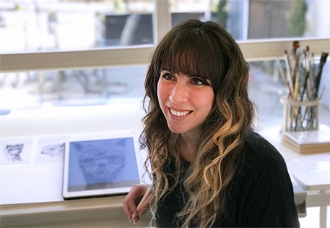
The beautiful Llama pictures are from: KRISTIN LLAMAS Fine ART www.kllamas.com THANK YOU, MRs. LLAMAS!
Kristin Llamas is a contemporary artist who believes that art is a doorway to discovery. She is currently creating an entire series of llama portraits in an effort to study first names. Playing upon her own name, the artist asks “¿Como te llamas?” or “How do you call yourself?” When individuals submit their naming story, Llamas draws or paints a llama with that name. Llamas lives and works in the Nashville area with her husband and three young daughters.

